Slide 1

Game Design Workshop

Slide 2
About The Workshop
Started in 2001
Hands-on
Focused on iteration
Grounded in a formal approach
Intended to be open-ended
Notes:
2

Slide 3
What It’s NOT about…
How to get a job as a game designer
How to write a design document
Where game ideas “come from”
How to get your game funded
How to use a level editor
Notes:
3

Slide 4
In Other Words...
It’s not about the Business
(Getting a job, pitching a game, getting funded)
It’s not about the Profession
(Writing documents, tracking bugs, using tools)
It’s about the Craft
(Making games that are fun)
Notes:
4

Slide 5

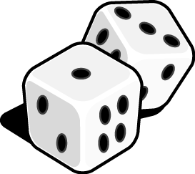
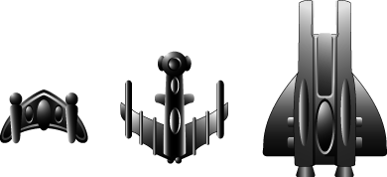
What You’ll be Doing
Playing games
Analyzing games
Critiquing games
Modifying games
Refining games
Notes:
5

Slide 6
Schedule
 |  | Day One |  |  |  |  |  | Day Two
10:00 AM |  | Introduction |  |  |  | 10:00 AM |  | Design Exercises
 |  |  |  |  |  |  |  |  | Design Problem
 |  | Design Exercises
 |  |  | Design Problem
11:00 AM |  |  |  |  |  | 11:00 AM
 |  |  | Discussion
 |  |  | Intro to MDA Framework
 |  |  | Work on Design Problem
12:00 PM |  |  |  |  |  | 12:00 PM |  |  |  | Lunch
 |  |  |  | Lunch
1:00 PM |  |  |  |  |  | 1:00 PM
 |  |  |  |  |  |  |  |  | Beta Test
2:00 PM |  |  |  |  |  | 2:00 PM |  |  | Discussion
 |  |  |  |  |  |  |  |  | More MDA Framwork
3:00 PM |  |  | Beta Test |  |  | 3:00 PM |  | Electives
 |  |  | & Discussion
 |  | Electives
4:00 PM |  |  |  |  |  | 4:00 PM
5:00 PM |  |  |  |  |  | 5:00 PM
 |  |  |  |  |  |  |  | Wrap Up, Q&A
6:00 PM |  |  |  |  |  | 6:00 PM
10am-6pm both days
Two 3½-hour Exercises
Four 2½-hour Electives
Go to http://gdc.8kindsoffun.com/
or tinyurl.com/gdc-mda
for details

Slide 7
Meet the Faculty

Slide 8
How We Can Help You
Concepts
Communication
Process
Sanity
Ideas

Slide 9
A Few Ground Rules
PvE, not PvP
Don’t bail on your group
Turn the devices off
Grab a pen
Last but not least…
Notes:
9

Slide 10
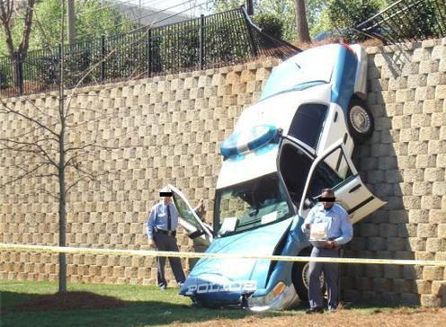
Fail Fast!

Slide 11
Fail Fast!
Test
Analyze
Revise

Slide 12
Fail Fast!
Test
Analyze
Revise
Follow the Fun!

Slide 24
Test
Analyze
Revise

Slide 26
Our exercises are longer
You will have way more rope
Melinda says...

Slide 27
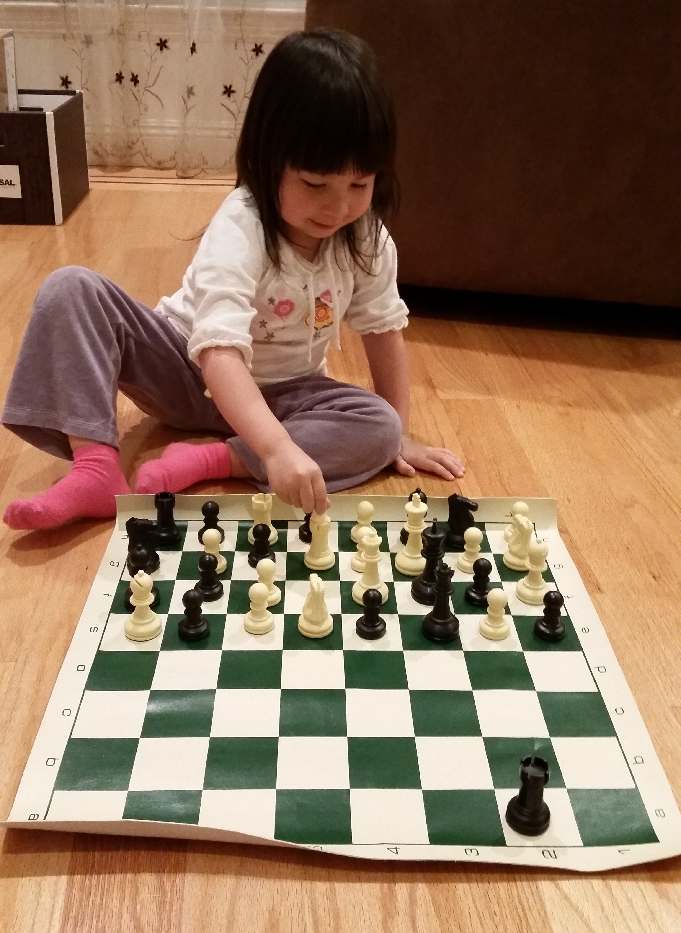
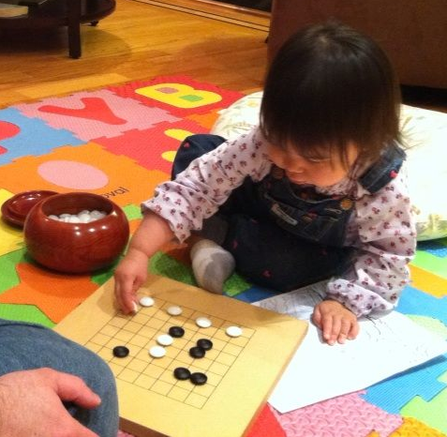
Channel your inner kindergartener…

Slide 28

Paper Simulations
of
Digital Games
Stone Librande
Lead Designer, Riot Games

Slide 29
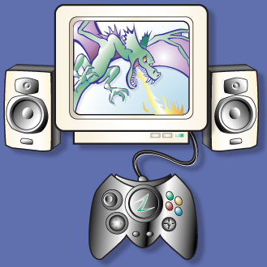
Take a digital game…

Slide 30
…remove the controller…

Slide 31

…remove the controller…

Slide 32
…the sound and music…

Slide 33

…the sound and music…

Slide 34
…and the graphics

Slide 35
…and the graphics

Slide 36
What’s left?

Slide 38
Paper Simulation
Simulate a video game using only pencils, index cards and dice.
Use it as a tool to help understand the game’s fundamental design principles.
Don’t sweat the details.

Slide 39
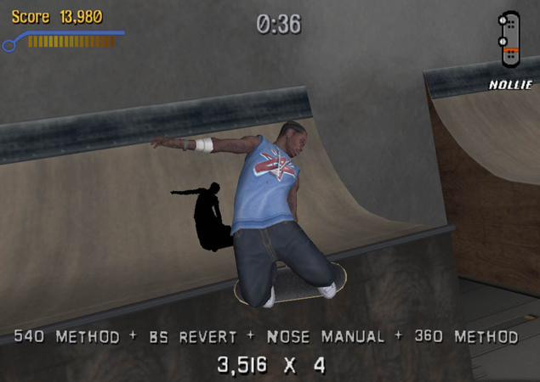
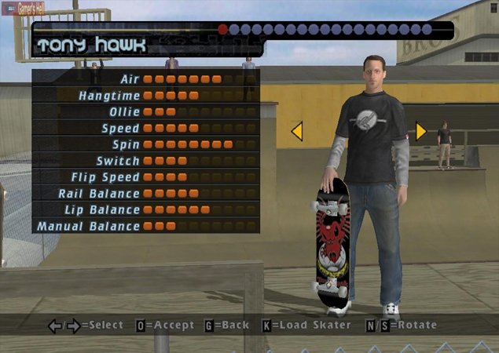
Example Game
Tony Hawk’s Pro Skater

Slide 40
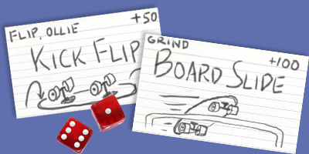
Example Game
Tony Hawk’s Pro Skater

Slide 41
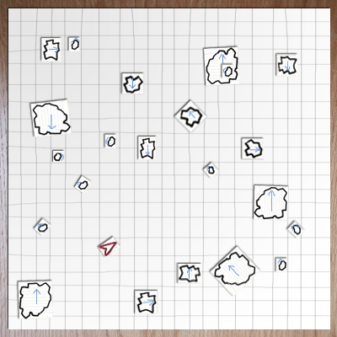
Asteroids

Slide 42
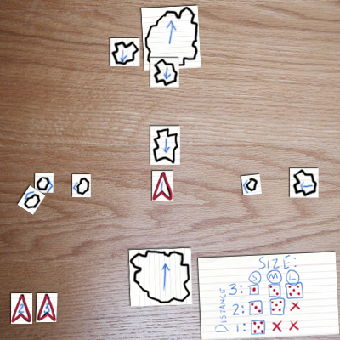
Asteroids

Slide 43
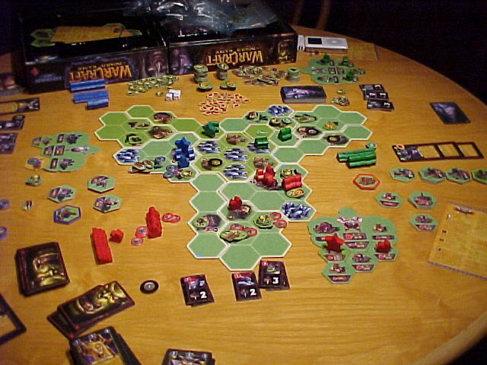
Warcraft
The Board Game

Slide 44
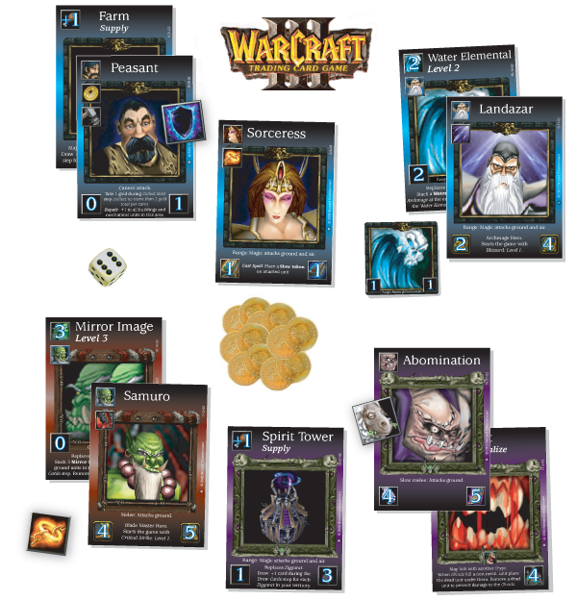
Warcraft
The Card Game
Notes:
Warcraft card game
Headhunter example

Slide 45
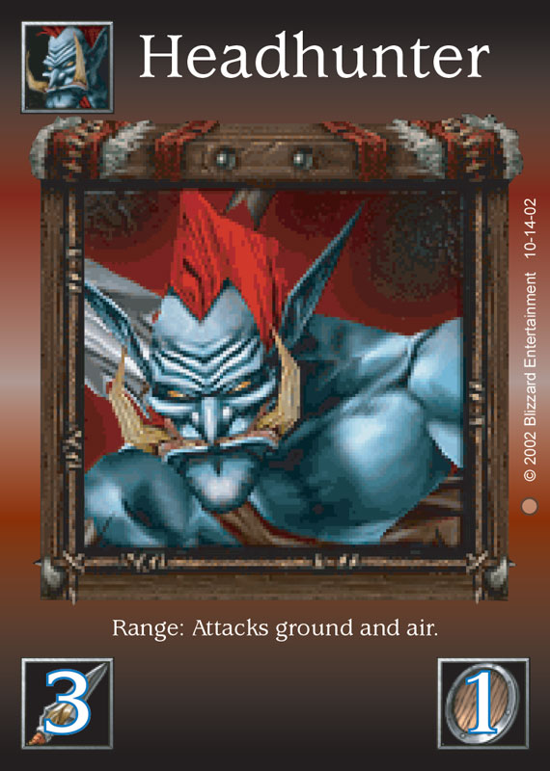
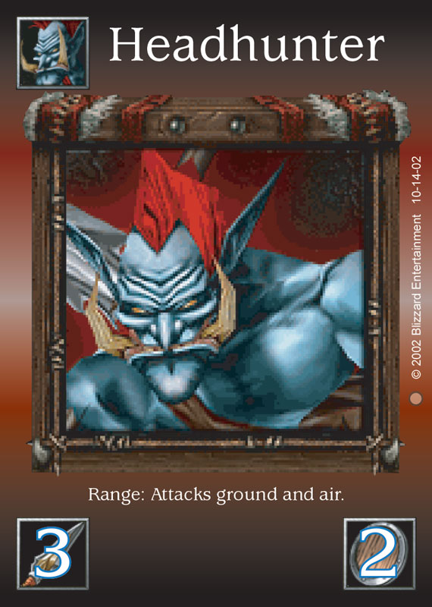
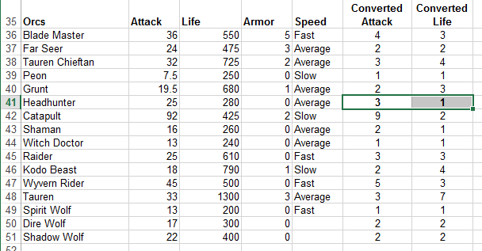
Warcraft
The Card Game

Slide 46

Notes:
Diablo card game
Kill monsters, get treasure, buy better stuff, kill bigger monsters, get bigger treasures…

Slide 47
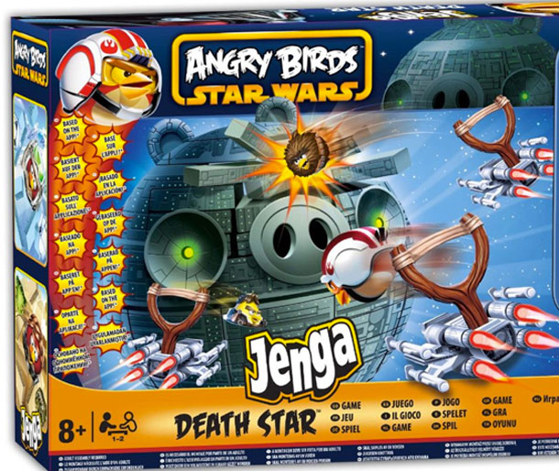

Slide 48
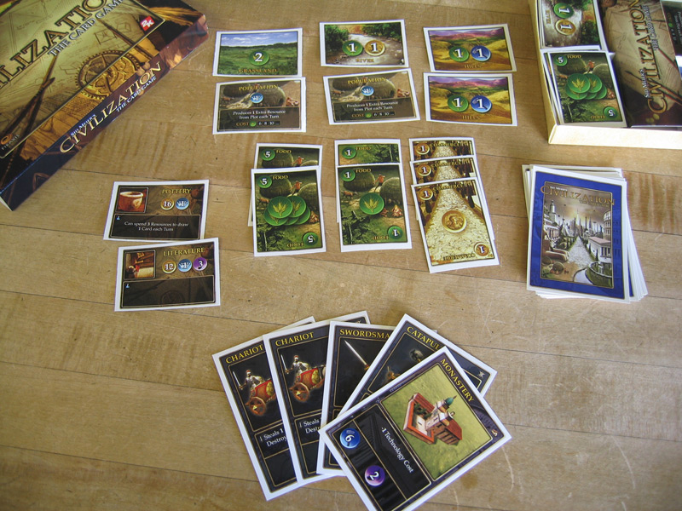
Civilization
The Card Game

Slide 49
Exercise
Select a digital game
Make a paper prototype
What aesthetics survive the change in medium?

Slide 50
Brainstorm
Name some games to “unplug”
Break into small groups

Slide 51
First Steps
  Write down three emotions you feel when playing the game.
  Pick one of the three to try to capture with your prototype.
  Write down your choice and put it in the middle of your table.

Slide 52
Build a Paper Version
What to do:
  Focus on the one emotion you picked.
  Identify the game actions that create that feeling

Slide 53
Build a Paper Version
What not to do:
  Don’t sweat the details
  Don’t try to duplicate the whole game
  Don’t focus on simulating computer functions
  Don’t make a board!

Slide 54
Lunch
Read about electives on gdc.8kindsoffun.com
or tinyurl.com/gdc-mda
Continue work at 1:30

Slide 55
Alpha Deadline at 2:00
Try to have something playable quickly!
Iterate!

Slide 56
How do we get from…
Cards
Dice
Rules
Notes:
56

Slide 57
To…
Cards
Dice
Rules
Discovery
Challenge
Drama
Notes:
57

Slide 58
What’s missing?
“Rules”
“Fun”
Notes:
58

Slide 59
The causal link…
“Rules”
“Activity”
“Fun”
This is what sets games apart…
Notes:
59

Slide 60
Games As Software
“Rules”
“Activity”
“Fun”
Code
Process
Requirements
Notes:
60

Slide 61
This is a systems view of games.
Input
Output
Logic
State

Slide 62
A Design Vocabulary
“Rules”
“Activity”
“Fun”
Code
Process
Requirements
Notes:
62

Slide 63
A Design Vocabulary
Mechanics
“Activity”
“Fun”
Process
Requirements
Notes:
63

Slide 64
A Design Vocabulary
Mechanics
Dynamics
“Fun”
Requirements
Notes:
64

Slide 65
A Design Vocabulary
Mechanics
Dynamics
Aesthetics
Notes:
65

Slide 66
The MDA Framework
Mechanics
Dynamics
Aesthetics
Notes:
66

Slide 67
The MDA Framework
Mechanics
Dynamics
Aesthetics
What do we mean?
Notes:
67

Slide 68
Mechanics
The concepts and materials that formally specify the game-as-system.
Everything you need to play.
Not just rules
Not just “Systemic Building Blocks”
Not “Technical execution of moves by players.” (eSports)

Slide 69
Dynamics
The run-time behavior of the game-as-system.
What happens when you play.

Slide 70
Aesthetics
The emotional content of the game.
How players feel when they play.
Not just visual or sensory qualities.
Cognitive rather than Behavioral

Slide 71
The Designer/Player Relationship


Mechanics
Dynamics
Aesthetics
Designer
Player
Notes:
71

Slide 72
The Player’s Perspective

Mechanics
Dynamics
Aesthetics
Player
Notes:
72

Slide 73
The Designer’s Perspective

Mechanics
Dynamics
Aesthetics
Designer
Notes:
73

Slide 74
MDA
A “Taxonomy” of Design Knowledge
  Aesthetics
  Dynamics
  Mechanics
  …and the interactions between them.
Notes:
74

Slide 75
Beta Test at 2:45
Make sure your rules are written down.

Slide 76
Beta Test
Send two testers to other tables.
Test until 3:15

Slide 77
Discussion

Slide 78
Using Paper Prototypes
Good for understanding existing games.
Use these techniques for games in progress.
Process is quick and cheap.
You don’t need programmers or artists.

Slide 79
Using Paper Prototypes
Can’t replace actual gameplay testing.
Can give you a head start and keep you focused.
Creates a vocabulary to use when discussing your game.
Can be used as a tool to educate other team members. Have them play, too!

Slide 80
Short Break
Electives Start at 3:35
Elective | Room
Game of Games | 120
Meaning as a Mechanic | 121
Us vs. It | 123
Horns of a Dilemma | 124

