Slide 1

Paper Simulations
of
Digital Games
Stone Librande
Lead Designer, Riot Games

Slide 2
Take a digital game…

Slide 3
…remove the controller…

Slide 4
…remove the controller…

Slide 5
…the sound and music…

Slide 6
…the sound and music…

Slide 7
…and the graphics

Slide 8
…and the graphics

Slide 9
What’s left?

Slide 11
Paper Simulation
Simulate a video game using only pencils, index cards and dice.
Use it as a tool to help understand the game’s fundamental design principles.
Don’t sweat the details.

Slide 12
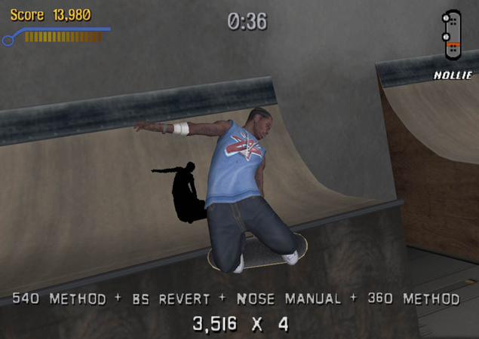
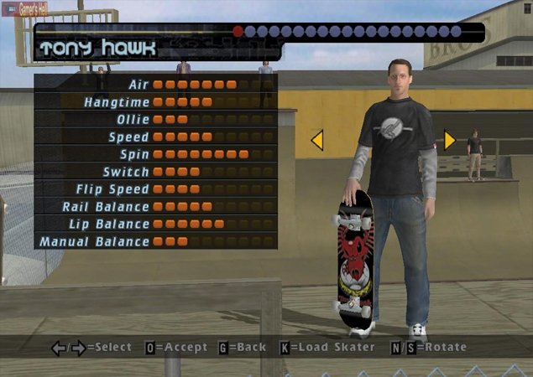
Example Game
Tony Hawk’s Pro Skater

Slide 13
Example Game
Tony Hawk’s Pro Skater

Slide 14
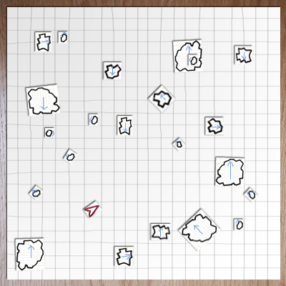
Asteroids

Slide 15
Asteroids

Slide 16
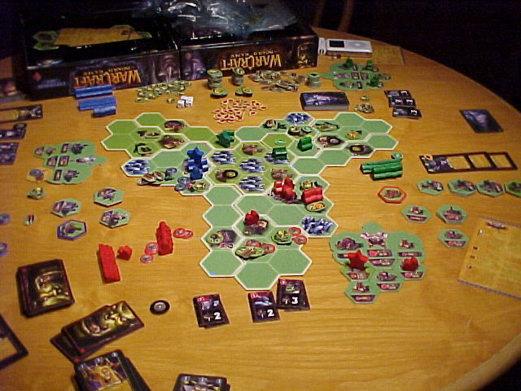
Warcraft
The Board Game

Slide 17
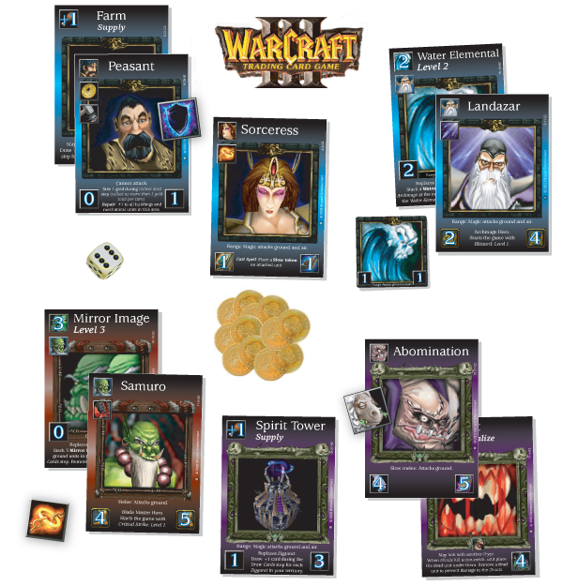
Warcraft
The Card Game
Notes:
Warcraft card game
Headhunter example

Slide 18
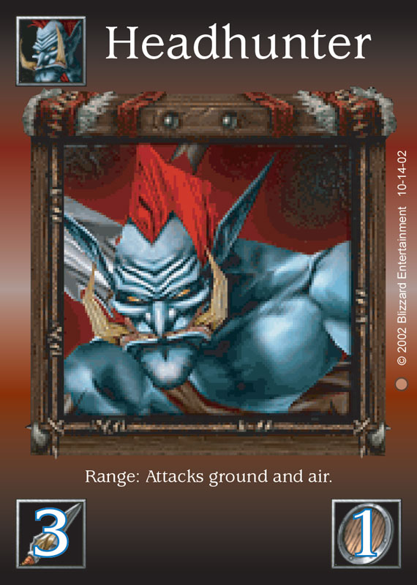
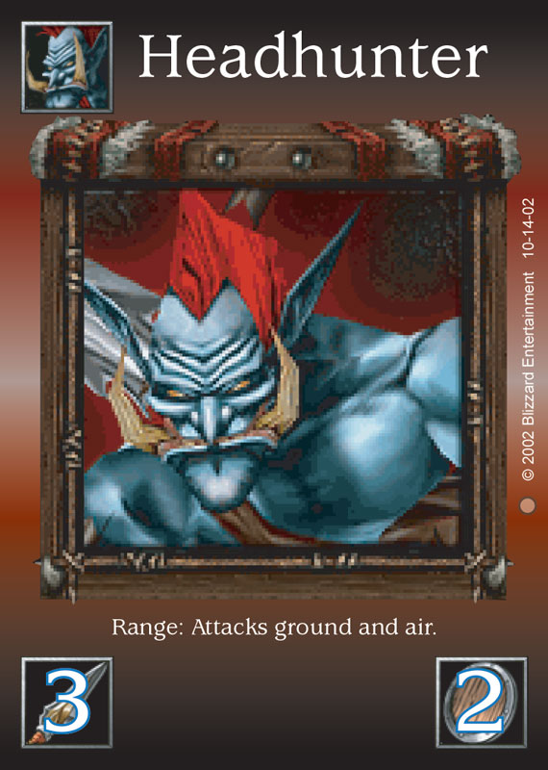
Warcraft
The Card Game

Slide 19
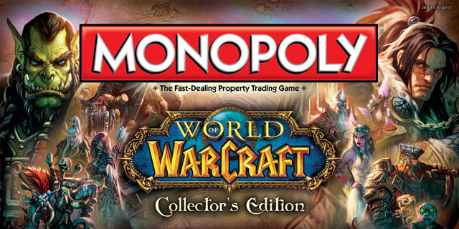
Notes:
Diablo card game
Kill monsters, get treasure, buy better stuff, kill bigger monsters, get bigger treasures…

Slide 20
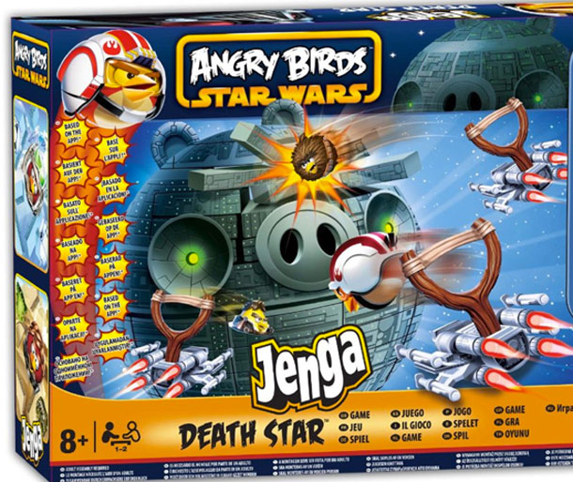

Slide 21
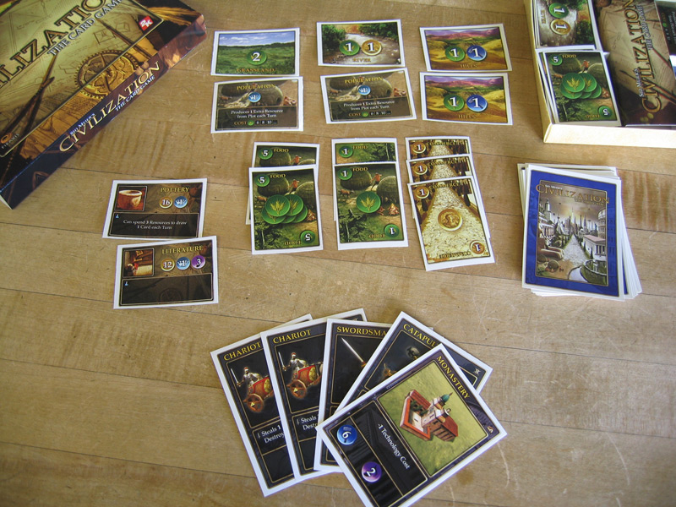
Civilization
The Card Game

Slide 22
Exercise
Select a digital game
Make a paper prototype
What aesthetics survive the change in medium?

Slide 23
Brainstorm
Name some games to “unplug”
Break into small groups

Slide 24
First Steps
  Write down three emotions you feel when playing the game.
  Pick one of the three to try to capture with your prototype.
  Write down your choice and put it in the middle of your table.

Slide 25
Build a Paper Version
What to do:
  Focus on the one emotion you picked.
  Identify the game actions that create that feeling

Slide 26
Build a Paper Version
What not to do:
  Don’t sweat the details
  Don’t try to duplicate the whole game
  Don’t focus on simulating computer functions
  Don’t make a board!

Slide 27
Alpha Deadline at 12:00
Try to have something playable quickly!
Iterate!

Slide 28
Lunch
Read about electives on gdc.8kindsoffun.com
or tinyurl.com/gdc-mda
Continue work at 1:30

Slide 29
Beta Test at 1:45
Make sure your rules are written down.

Slide 30
Beta Test
Send two testers to other tables.
Test until 2:05

Slide 31
Discussion
2:30

Slide 32
Using Paper Prototypes
Good for understanding existing games.
Use these techniques for games in progress.
Process is quick and cheap.
You don’t need programmers or artists.

Slide 33
Using Paper Prototypes
Can’t replace actual gameplay testing.
Can give you a head start and keep you focused.
Creates a vocabulary to use when discussing your game.
Can be used as a tool to educate other team members. Have them play, too!

Slide 34
The MDA Framework
Mechanics
Dynamics
Aesthetics
Notes:
34

Slide 35
Understanding Aesthetics
We need to get past words like “fun” and “gameplay.”
What kinds of “fun” are there?
Notes:
35

Slide 36
Eight Kinds of “Fun”
Notes:
36

Slide 37
Eight Kinds of “Fun”
Sensation
Game as sensory experience.
Notes:
37

Slide 38
Eight Kinds of “Fun”
Sensation
Fantasy
Game as make-believe
Notes:
38

Slide 39
Eight Kinds of “Fun”
Sensation
Fantasy
Narrative
Game as unfolding story
Notes:
39

Slide 40
Eight Kinds of “Fun”
Sensation
Fantasy
Narrative
Challenge
Game as obstacle course
Notes:
40

Slide 41
Eight Kinds of “Fun”
Sensation
Fantasy
Narrative
Challenge
Fellowship
Game as social framework
Notes:
41

Slide 42
Eight Kinds of “Fun”
Sensation
Fantasy
Narrative
Challenge
Fellowship
Discovery
Game as uncharted territory
Notes:
42

Slide 43
Eight Kinds of “Fun”
Sensation
Fantasy
Narrative
Challenge
Fellowship
Discovery
Expression
Game as soap box
Notes:
43

Slide 44
Eight Kinds of “Fun”
Sensation
Fantasy
Narrative
Challenge
Fellowship
Discovery
Expression
Submission
Game as mindless pastime
Notes:
44

Slide 45
Clarifying Our Aesthetics
Charades is “fun”
Team Fortress is “fun”
Final Fantasy is “fun”
Notes:
45

Slide 46
Clarifying Our Aesthetics
Charades is
  Fellowship, Expression, Challenge
Team Fortress is
  Competition, Schadenfreude, Challenge, Sensation, Fantasy
Final Fantasy is
  Fantasy, Narrative, Expression, Discovery, Challenge, Masochism
Notes:
46

Slide 47
Each game pursues multiple aesthetics.
No Grand Unified Theory.

Slide 48
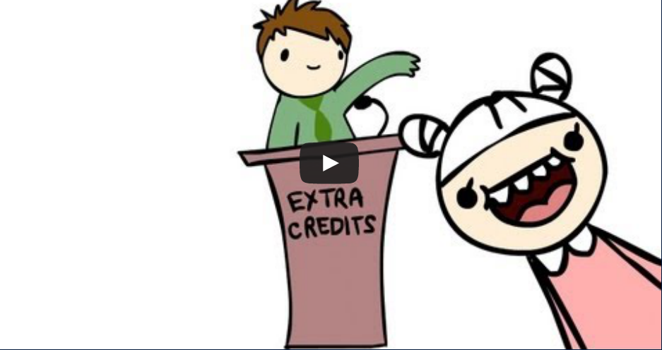
More on Aesthetics
Check out: Extra Credits – Aesthetics of Play

Slide 49
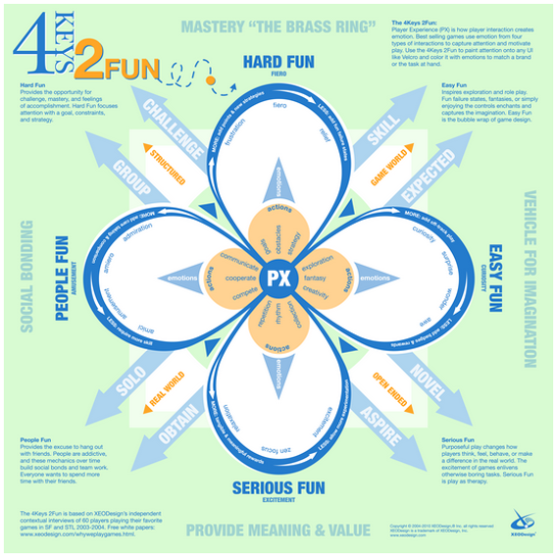

See Also: Nicole Lazzaro

Slide 50
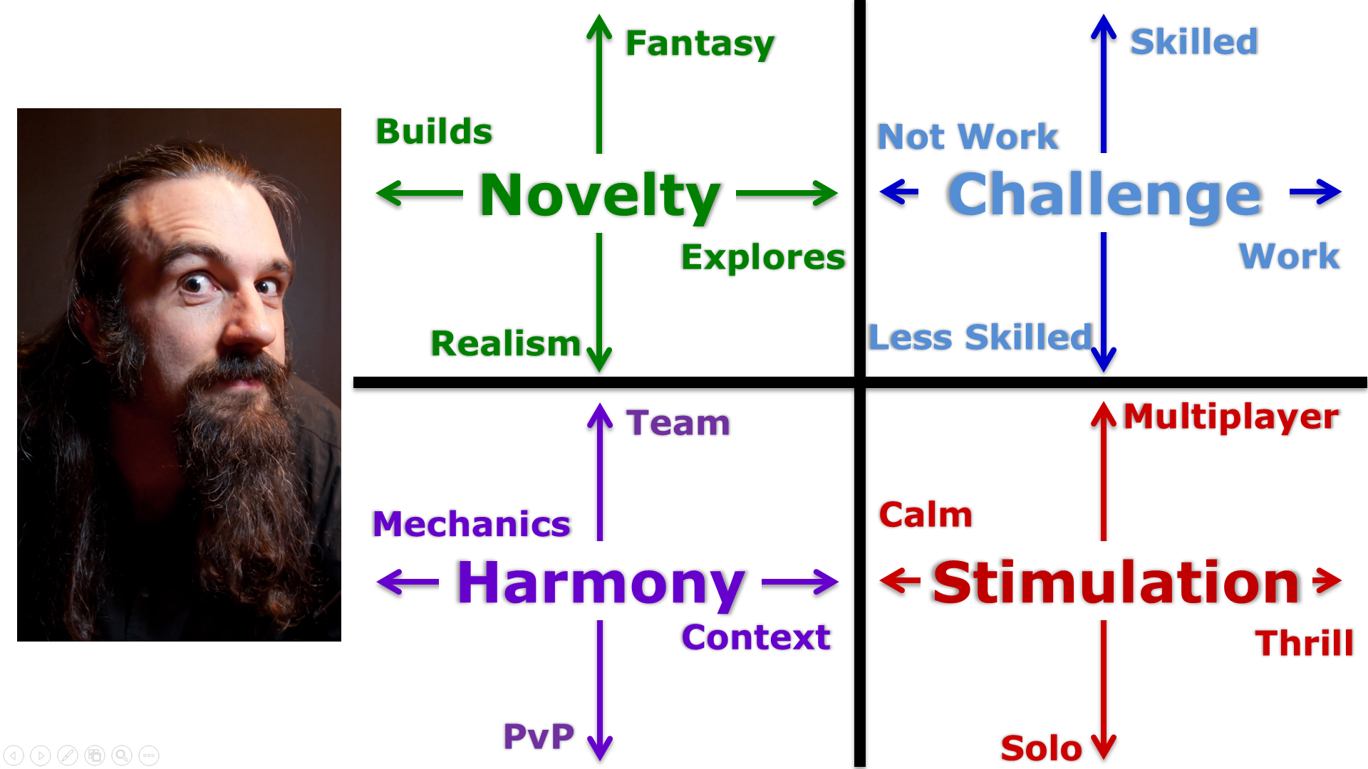
See Also: Jason VandenBerghe

Slide 51
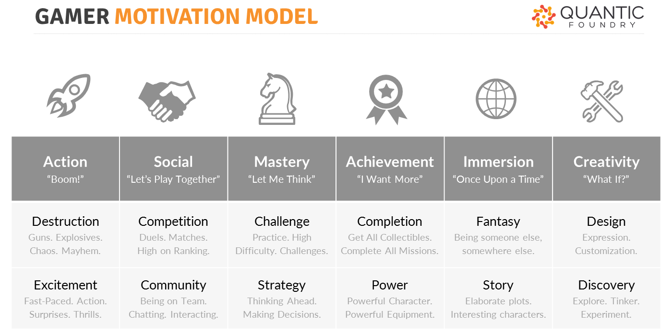
See Also: Quantic Foundry

Slide 52
Clarifying Our Goals
As designers, we can choose certain aesthetics as goals for our game design.
We need more than a one-word definition of our goals.
Notes:
52

Slide 53
A Few Words on Dynamics
We can use abstract models to explain and predict game behaviors.

Slide 54
Example: The “Scourge Factor”
Game
Is Someone
Winning?
Team Attack!
Let’s gang up!

Slide 55
Model: Feedback Loop
STATE
Measure
Act
Decide

Slide 56




These Models are Well Understood
Room
Thermometer
Heater
Too Cold
Too Hot
Controller
Cooler
An Ideal Thermostat
Notes:
56

Slide 57
Short Break
Electives Start at 3:05
Elective | Room
Game of Games | 120
Meaning as a Mechanic | 121
Us vs. It | 122
Games That Teach | 123
Horns of a Dilemma | 124
Design Jam | 125

