Slide 1

Paper Simulations
of
Digital Games
Stone Librande
Creative Director, EA/Maxis
Notes:
The Games
These games were not intended to be sold. They had a very specific audience—my 2 sons.
This is a major point. By deciding up front that you have no intention of marketing or selling your game then you instantly gain complete freedom as a designer. Suddenly you no longer have to worry about time, money, and team constraints.
You don’t have to make compromises with business guys (it’s your bank account, so spend as much as want), production people (who cares if has too many pieces), or the marketing team (the game is its own advertisement).

Slide 2

Take a digital game…

Slide 3
…remove the controller…

Slide 4

…remove the controller…

Slide 5
…the sound and music…

Slide 6
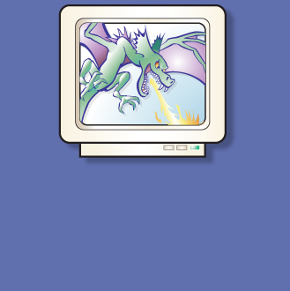
…the sound and music…

Slide 7
…and the graphics

Slide 8
…and the graphics

Slide 9
What’s left?

Slide 11
Exercise #2
Simulate a video game using only pencils, index cards and dice.
Use it as a tool to help understand the game’s fundamental design principles.
Don’t sweat the details.

Slide 12
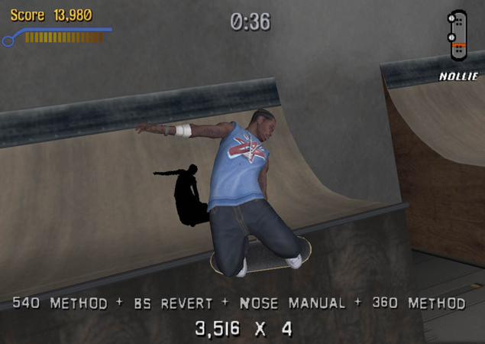
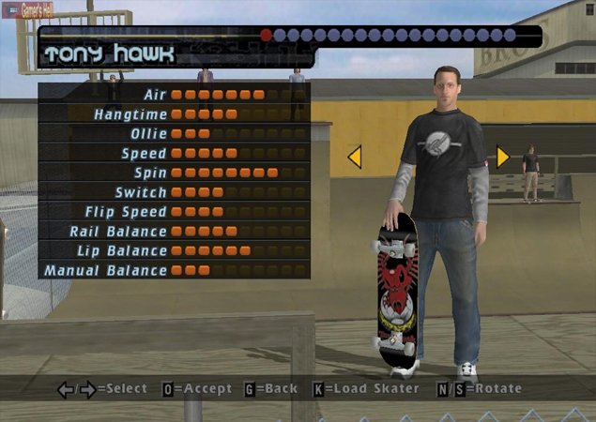
Example Game
Tony Hawk’s Pro Skater

Slide 13
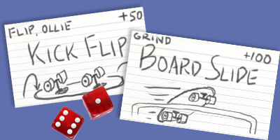
Example Game
Tony Hawk’s Pro Skater

Slide 14
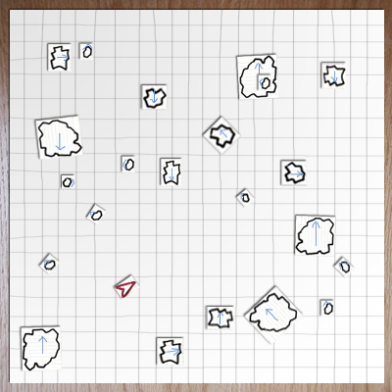
Asteroids

Slide 15
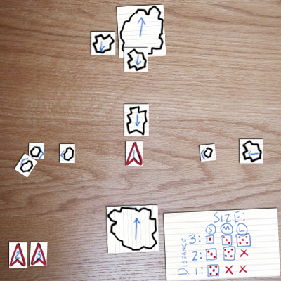
Asteroids

Slide 16
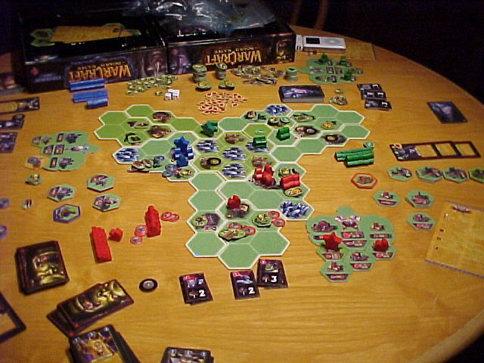
Warcraft
The Board Game

Slide 17
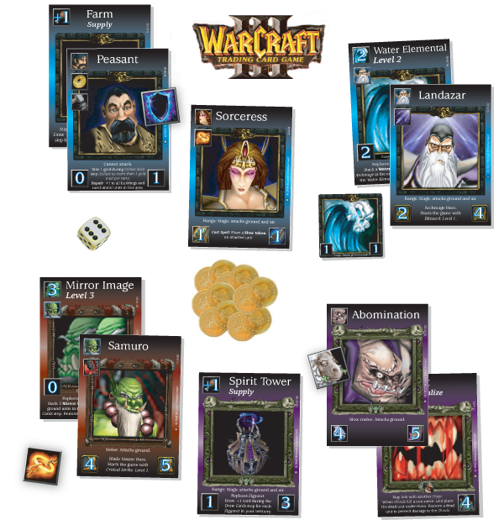
Warcraft
The Card Game
Notes:
Diablo card game
Kill monsters, get treasure, buy better stuff, kill bigger monsters, get bigger treasures…

Slide 18
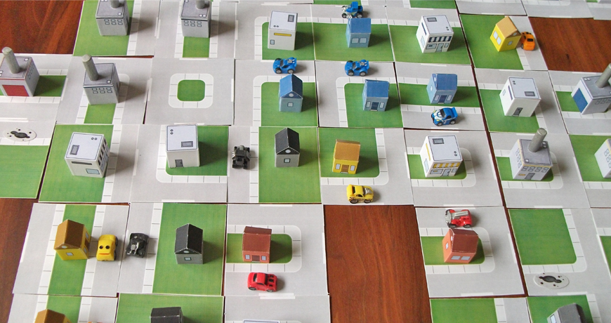

Slide 19
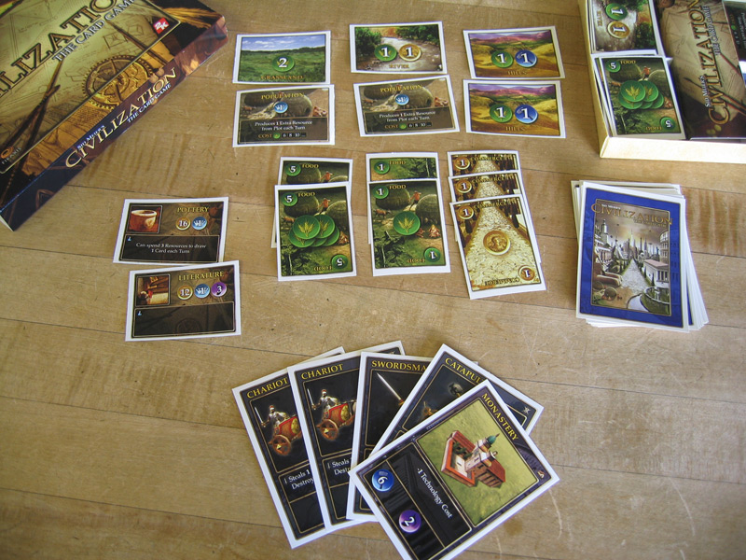
Civilization
The Card Game

Slide 20
Exercise
Select a digital game
Make a paper prototype
What aesthetics survive the change in medium?

Slide 21
Brainstorm
Name some games to “unplug”
Break into groups

Slide 22
Build a Paper Version
What To Do
  Identify your game’s play aesthetics
  Choose one aesthetic element to capture
  Write it down and put it in the middle of your table
  Identify the game actions that create that feeling

Slide 23
Build a Paper Version
What Not to Do
  Don’t sweat the details
  Don’t try to duplicate the whole game
  Don’t focus on simulating computer functions
  Don’t make a board!

Slide 24
Alpha Deadline at 12:00
  Try to have something playable quickly!
  Iterate!

Slide 25
Lunch
Sign up for electives at
http://gdc.8kindsoffun.com
or
http://tinyurl.com/gdc-mda
Back here at 1:30

Slide 26
Beta Test at 1:45
  Make sure your rules are written down.

Slide 27
Beta Test
Send two testers to other tables.
Test until 2:15

Slide 28
Discussion
Let’s share results.
What aesthetics did you capture?
What did you leave out?

Slide 29
The Message
Play transcends media
  Mechanics
  Dynamics
  Aesthetics
Sometimes.

Slide 30
Using Paper Prototypes
Good for understanding existing games.
Use these techniques for games in progress.
Process is quick and cheap.
You don’t need programmers or artists.

Slide 31
Using Paper Prototypes
Can’t replace actual gameplay testing.
Can give you a head start and keep you focused.
Creates a vocabulary to use when discussing your game.
Can be used as a tool to educate other team members. Have them play, too!

Slide 32
Elective B
236: Us vs. It
224: Supply Chain
220: Three Musketeers

